Slide 1

FortiGate Lab: Security Fundamentals
This lab provides a hands-on learning experience with FortiGate firewalls. You'll explore key security features, network configurations, and best practices.

Slide 2
Objective of the Lab
1
Accessing the FortiGate CLI
2
Backing Up and Restoring
3
Model and Firmware
You'll practice locating and interpreting the FortiGate model and FortiOS firmware version from the configuration file.
You'll learn to connect to the FortiGate command-line interface (CLI) and navigate its commands.
This section explores how to create backups and restore configuration files for disaster recovery and configuration management.
4
Creating a User
5
Restricting Access
This involves creating a new administrator user account with appropriate permissions and roles.
You'll learn how to set up access restrictions and control permissions for administrators to enhance security.

Slide 3




Accessing the FortiGate CLI
SSH Connection
Establish a secure SSH connection to the FortiGate device using a terminal emulator like Putty.
Authentication
Login with your credentials: admin/admin or the credentials of the designated user.
Command Prompt
You'll be presented with the FortiGate CLI, allowing you to execute commands and manage the device.

Slide 4
Backing Up and Restoring Configuration Files
Backup
Save
Restore
Use the 'get system config' command to generate a configuration file that contains the device settings.
Save the configuration file to a secure location, like a USB drive, for safekeeping.
Utilize the 'config system from-file' command to load the configuration file back onto the FortiGate device.

Slide 5
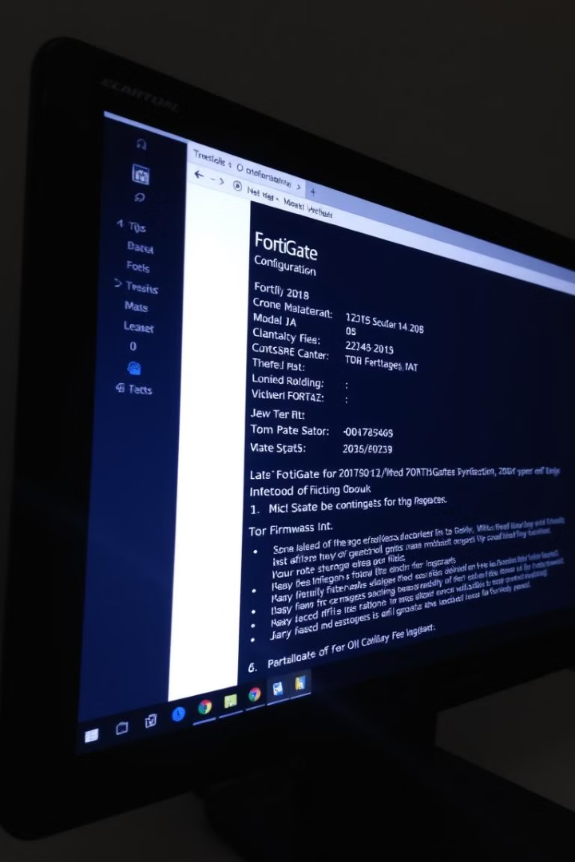
Locating the FortiGate Model and FortiOS Firmware Build
Command
Information
get system status
Model, serial number, hardware revision
get system version
FortiOS version, build number, and release date

Slide 6
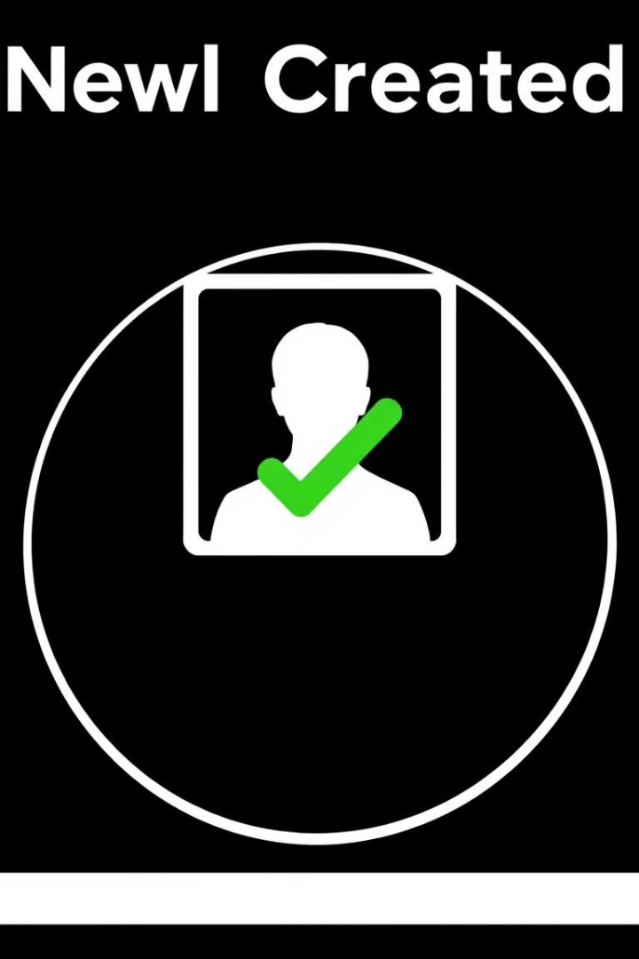
Creating a New Administrator User
1
User Creation
Use the 'config user' command to create a new user account.
2
Role Assignment
Specify the user's role and permissions using the 'config role' command.
3
Password Configuration
Set a strong password for the new user to ensure security.

Slide 7




Restricting Administrator Access
Access Control Lists (ACLs)
Use ACLs to restrict access to specific network resources based on IP addresses, ports, and protocols.
Firewall Policies
Configure firewall policies to control traffic flow and block unauthorized access based on defined rules.
User Roles
Assign granular permissions to different user roles to control the actions they can perform on the FortiGate device.

Slide 8
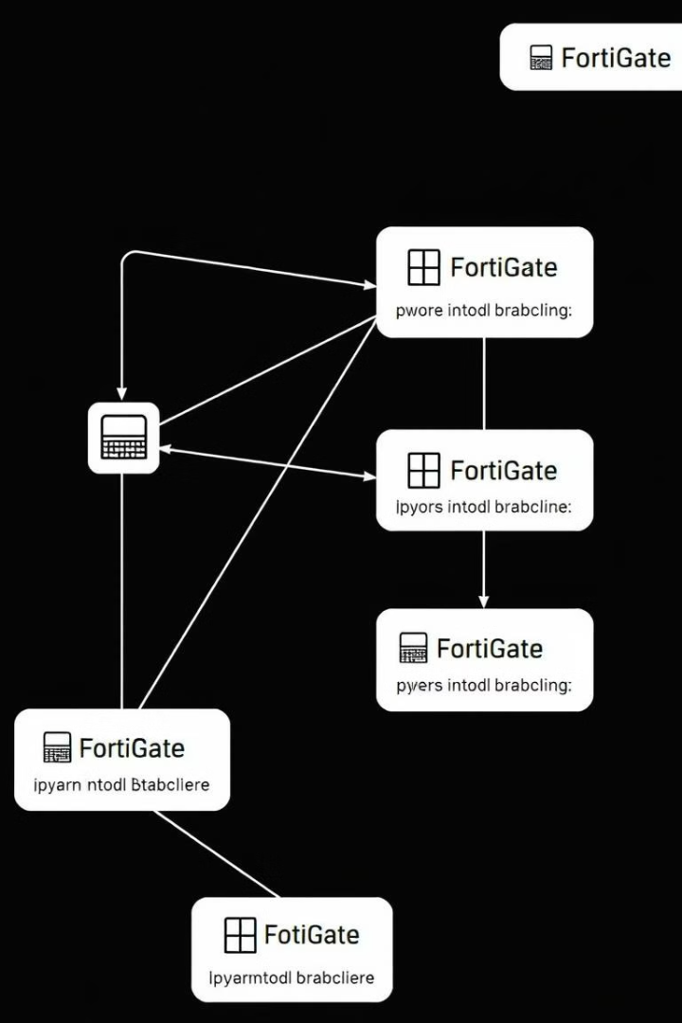
Lab Setup
Local-Client VM
Remote-Client VM
Represents a user or device within the internal network, interacting with the FortiGate.
Represents a user or device outside the internal network, attempting to access resources.
Local-FortiGate VM
Remote-FortiGate VM
The primary FortiGate device in the lab, acting as a firewall and security gateway.
An optional FortiGate device in the lab, demonstrating advanced security configurations and inter-device communication.

